Slide 1
Florida Statewide Managed Medicaid
Susan Bramer, LCSW
AVP Behavioral Health, Amerigroup

Slide 2
Source for Today’s Overview (Slides 2-6)

Slide 3
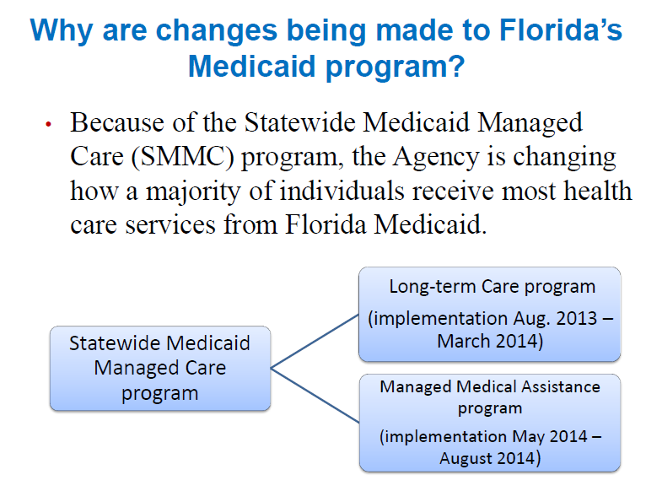

Slide 4
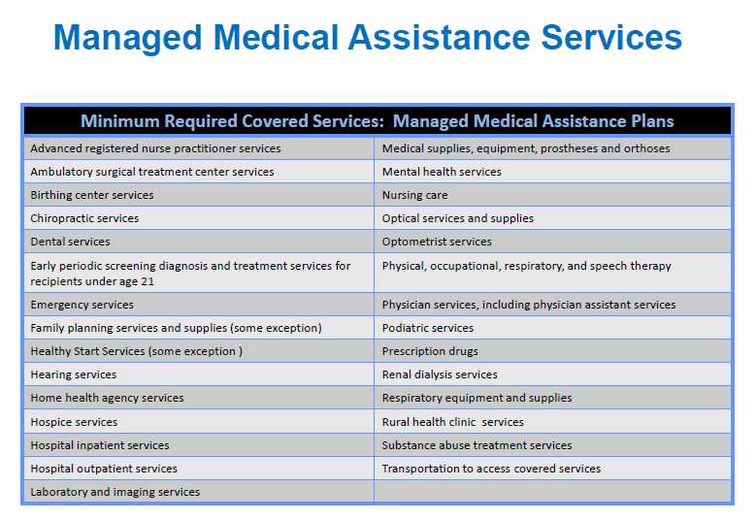

Slide 7
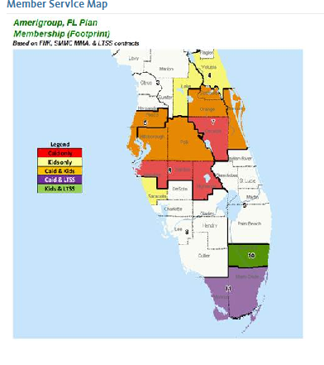

Slide 8
Amerigroup Policy & Procedure re: Members involved in DJJ/Criminal Justice System

Slide 9
Questions?

